Slide 1
Welcome To Our Project!!!
EARLY DETECTION OF CHRONIC KIDNEY DISEASE USING MACHINE LEARNING
- An Inventory Project for Nephrology
SPOC : Dr. A. Bhuvaneswari M.E.,Ph.D.,
Mentor : Dr.N.Elamathi M.E.,Ph.D.,
Evaluator : Mr.M.Ezhilvendan M.Tech.,
Industry Mentor: Lalitha Gayathri mam

Slide 2
TEAM DETAILS - PNT2022TMID38667
TEAM LEAD:
SAHANA R
TEAM MEMBERS:
KANIMOZHI D (TM1)
KEERTHANA V (TM2)
TAMILARASI S (TM3)
BHAVANI G (TM4)

Slide 3
PROBLEM STATEMENT
Kidney disease affected patients need a way to detect the presence of the disease at early date to slow down or stop the progress of chronic kidney failure which not only reduce the facilites but also the pain experienced by the paitent while undergoing the treatment.
Patients need to follow healthy diet by maintaining a balance of sodium, potassium, phosphrous, protien and fluids in the diet to keep the kidneys stronger, safer and healthier.
With the parameters checked prior, there is no need of a people to seek the hospitals.we can diagnose the CKD,with our project, in their home itself.

Slide 4
PROPOSED SOLUTION
The proposed system acts as a decision support with feature embedding method and tuning of hyper parameters and will prove to be an aid for the physicians .
The algorithm, Random Forest is best able to predit progression to CKD.
The model had accuracy of 93.97% and sensitivity and specificity of 80.60% and 95.27%, respectively.
Machine learning algorithms can effectively predict which patients with IgA nephrology will progress to end stage renal disease.

Slide 5
TECHICAL ARCHITECTURE
We have used feature embedding method and tuning of hyper parameters to increase the accuracy and to built a website that is compatible to support large datasets.
Need to create the notebook file
Create frontend and backend with flask
Integrate them

Slide 6
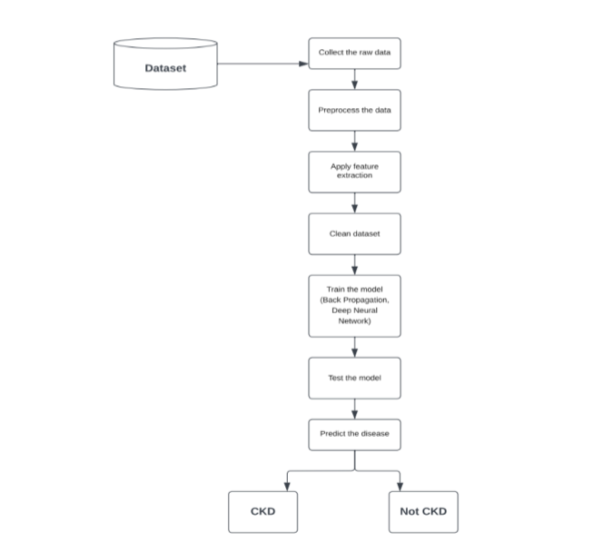

Slide 7
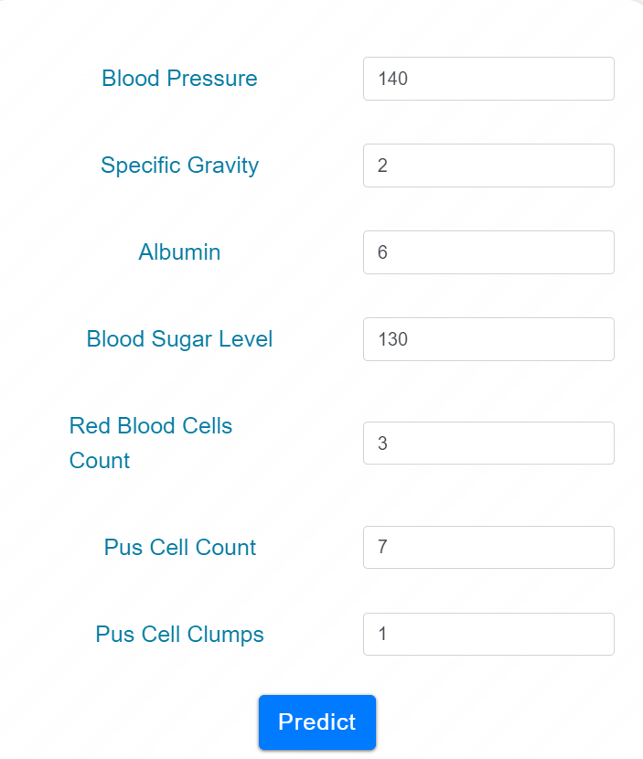
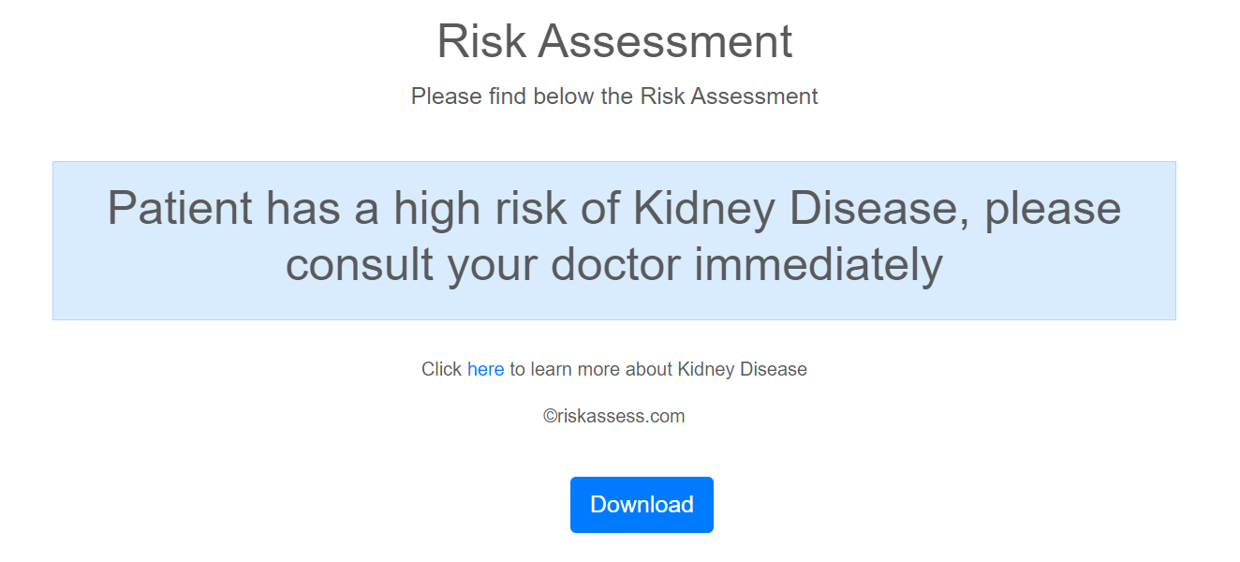
WORKING DEMO OF THE PROJECT

Slide 8
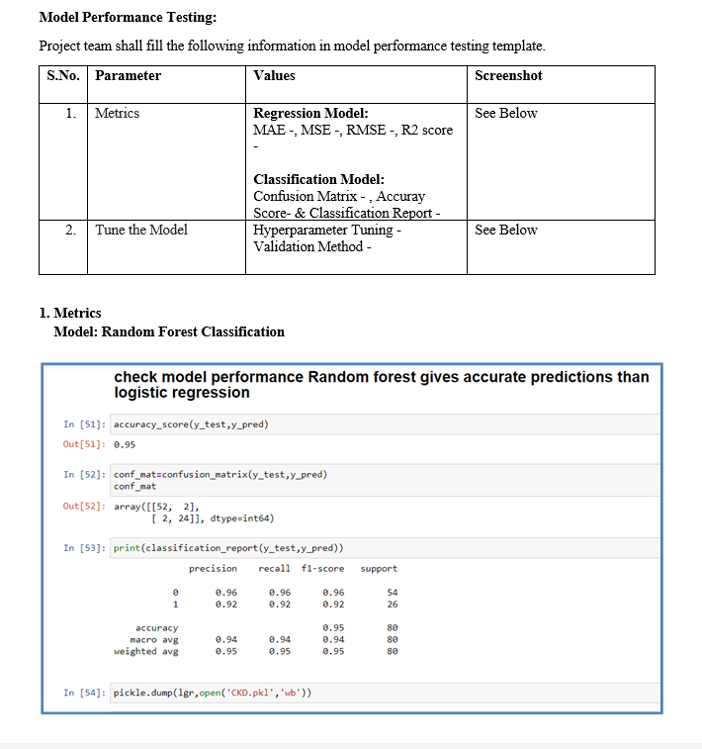
PERFORMANCE METRICS

Slide 9
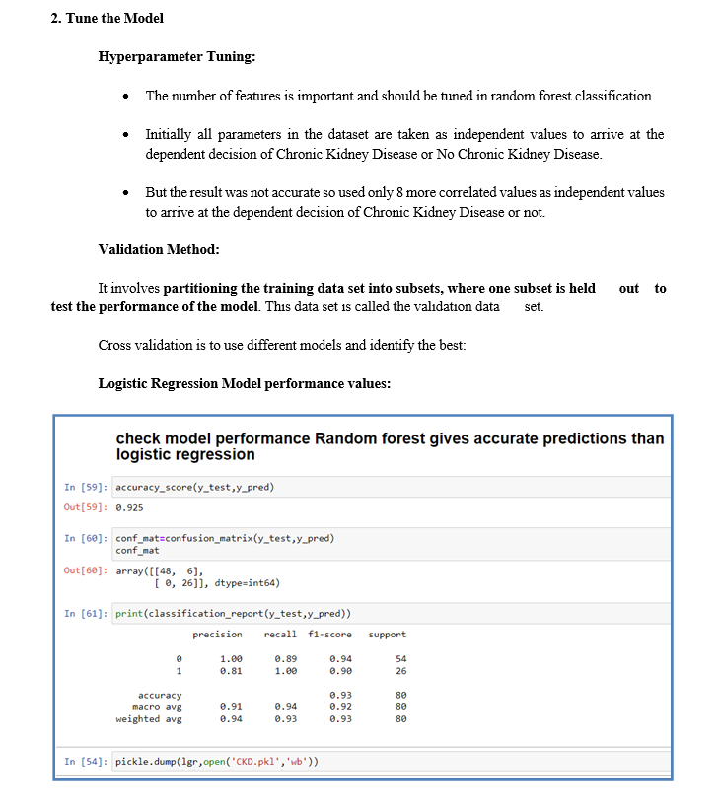

Slide 10
FUTURE SCOPE
This software can be used to detect various other chronic diseases by modifying the dataset and the user inputs received. The model can be further trained with enormous amount of data to improve the accuracy.

Slide 11
Thanks a lot !!!
Happy Ending ☺

